Slide 1
PATENT
A patent is an exclusive right granted for an invention, which is a product or a process that provides, in general, a new way of doing something, or offers a new technical solution to a problem. To get a patent, technical information about the invention must be disclosed to the public in a patent application.

Slide 2
What kind of protection does a patent offer?
In principle, the patent owner has the exclusive right to prevent or stop others from commercially exploiting the patented invention. In other words, patent protection means that the invention cannot be commercially made, used, distributed, imported or sold by others without the patent owner's consent.

Slide 3
Is a patent valid in every country?
Patents are territorial rights. In general, the exclusive rights are only applicable in the country or region in which a patent has been filed and granted, in accordance with the law of that country or region.
How long does a patent last?
The protection is granted for a limited period, generally 20 years from the filing date of the application.

Slide 4
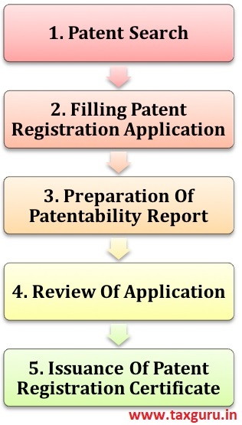

Slide 5
Patents may be searched using the following resources:
Patent Public Search
USPTO Patent Full-Text and Image Database (PatFT)
USPTO Patent Application Full-Text and Image Database (AppFT)
Global Dossier
Patent Application Information Retrieval (PAIR)
Public Search Facility
Patent and Trademark Resource Centers (PTRCs)
Patent Official Gazette
Common Citation Document (CCD)
Search International Patent Offices
Search Published Sequences
Patent Assignment Search
Patent Examination Data System (PEDS)

Slide 6
https://ipindiaservices.gov.in/publicsearch
(https://www.uspto.gov/)

